Slide 1
Vehicle Classifaction and Detection
Vision and perception project
Presented by,
Akshayaa Udayakumar

Slide 2
What is image classification and detection
Image Classification helps us to classify what is contained in an image. Image Localization will specify the location of single object in an image whereas Object Detection specifies the location of multiple objects in the image
For the same application, I have 2 approaches where 1 include usage of neural networks and the other with just image processing techniques.

Slide 3
dataset for neural netowrks
For this task, I have used the COCO Dataset
The dataset consists of more than 80 classes, I have only extracted the classes [truck, car, buses] for the classification task.

Slide 4
Approach: with neural networks
train the network on dataset
save the weights
take video input
preprocess the image/video
send it to the network
Evaluating the results.

Slide 5
Approach: with no neural networks
Take the image/video
Perform image processing
Evaluate the results

Slide 6
Network and model:
At first, the program was developed just using the image processing techniques (just for 2 classes i.e a truck and a car) with no use of neural networks. Then,
Usage of custom network and a YOLOv3 net (trained on the COCO dataset) are used, so we read the file that contains all the class names and store the names in a list.
In my task, the program need to detect only vehicles (in this case, cars, buses, trucks) for this project, that’s why the required_class_index contains the index of those classes from the coco dataset.

Slide 7
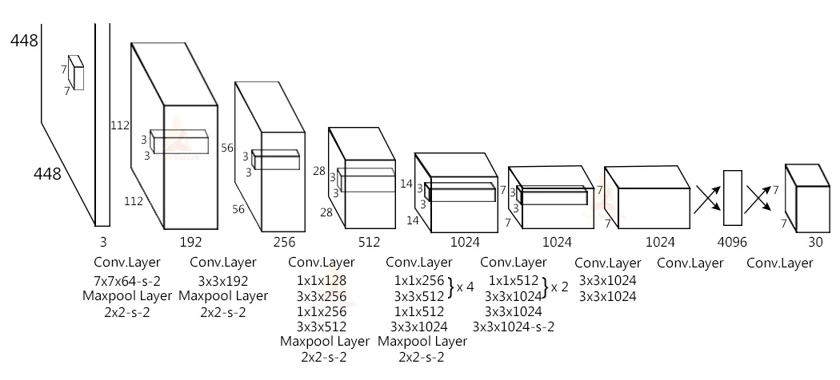
Yolo Architechture:

Slide 8
Preprocessing: with no neural networks
The program takes a video as input, some image processing techniques such as:
Background Subtractor, masking
thresholding
Contours extraction, finding centroids
I used to preprocess the frames.

Slide 9
Preprocessing: with neural networks
The program YOLO takes 320×320 image objects as input. The input to the network is a blob object. The function dnn.blobFromImage() takes an image as input and returns a resized and normalized blob object.
The net.forward() is used to feed the image to the network. And it returns an output.
And finally, we call our custom postProcess() function to post-process the output.

Slide 10
Non-max suppression
YOLO sometimes gives multiple bounding boxes for a single object, so we have to reduce the number of detection boxes and have to take the best detection box for each class.
Using the NMSBoxes() method we reduce the number of boxes and take only the best detection box for the class.

Slide 11
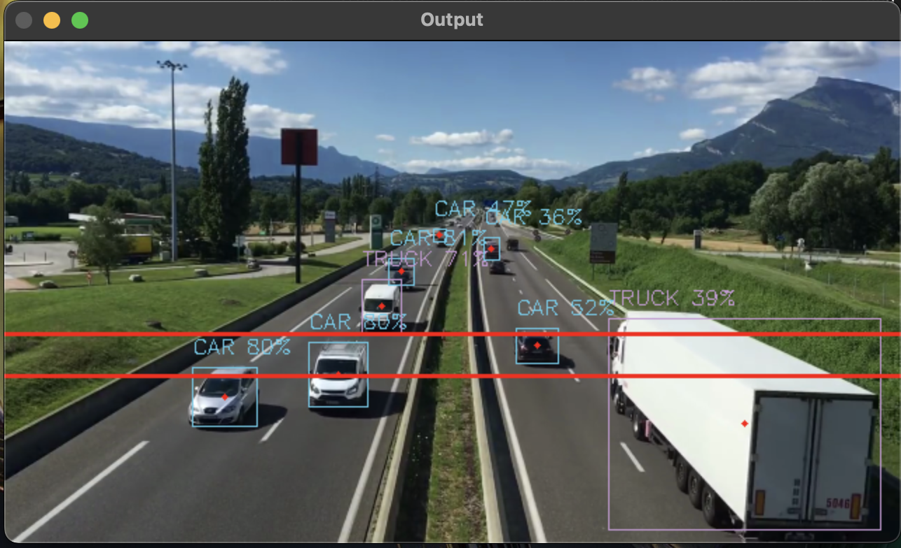
Output: with Neural Networks:
The network forward output contains 3 outputs. Each output object is a vector of length 85.
4x the bounding box (centerX, centerY, width, height)
1x box confidence

Slide 12
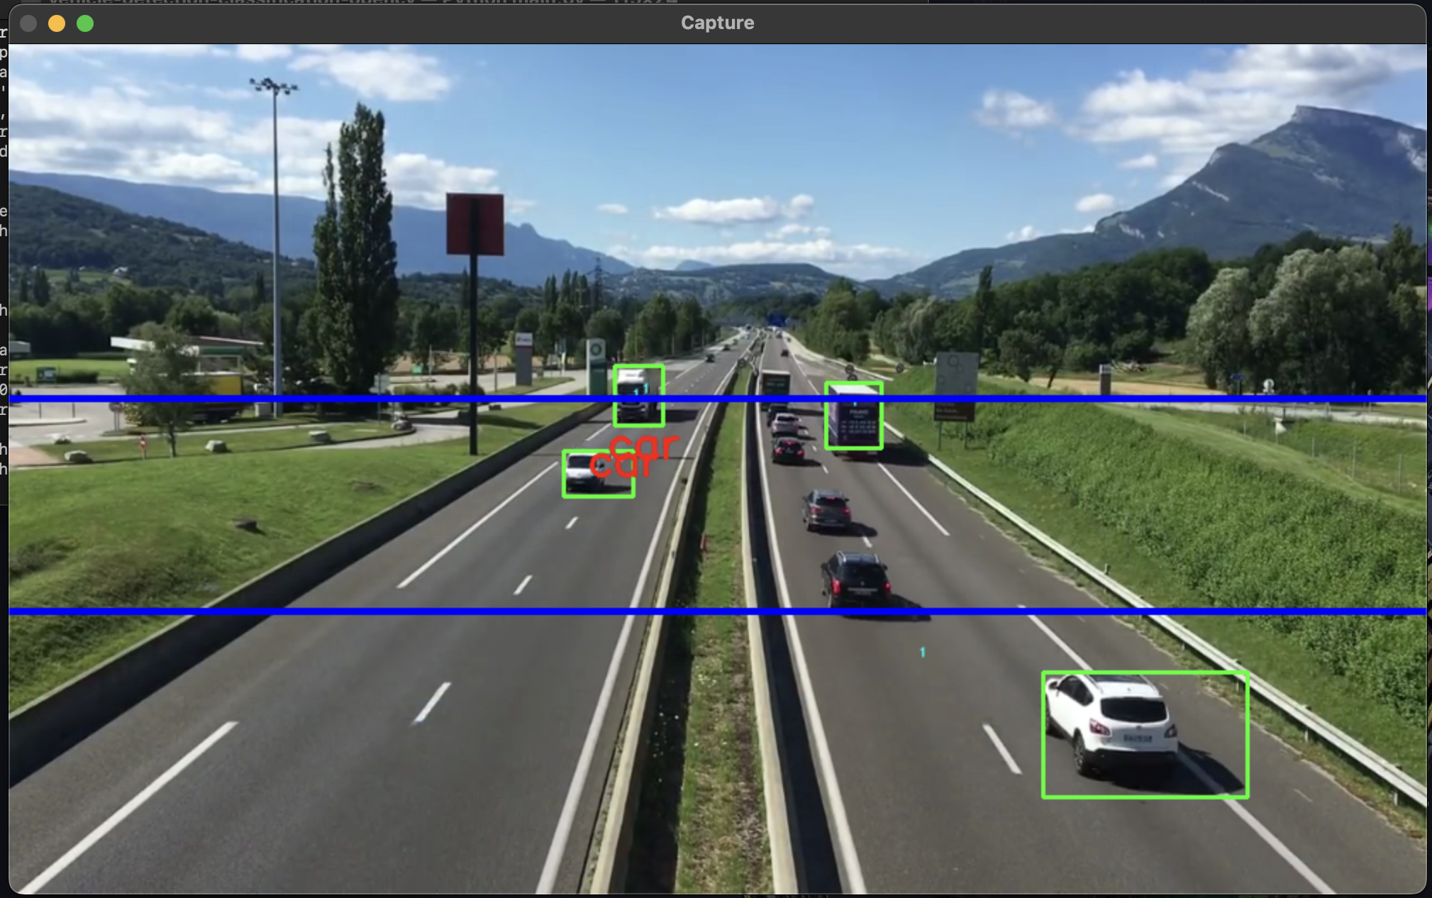
Output: with NO Neural Networks:
The output of the following program is a video that consists of detection (bounding boxes) of objects of 2 classes i.e cars and trucks.

Slide 13
Comparisions and conclusions:
With neural networks | Without Neural networks
1. Processing speed is much slower. | 1. Very quick processing and no latency between frames
2. Harder constuction of program and involves the usage of multiple techonlogies and requires more computation power. | 2. Ligher model and requires a bit lower computation power and easier to understand.
3. Can be scalled to many objects very easily | 3. Cannot be scalled, if tried, we need more analysis on the detection objects.

Slide 14
Thank You

